Slide 1


ECG Signal Analysis for Cardiac Anomaly Detection
Bachelor of Technology in Computer Science & Engineering
Presented By
2200520109102 Devansh Kushwaha
2200520109105 Rajat Kumar
Under the guidance of
Dr. Aditi Sharma (Assistant Professor CSE Dept.)
Mrs. Sonam Srivastava (Assistant Professor CSE Dept.)
Department of Computer Science and Engineering
INSTITUTE OF ENGINEERING AND TECHNOLOGY
(Sitapur Road, Lucknow, Uttar Pradesh, India)

Slide 2
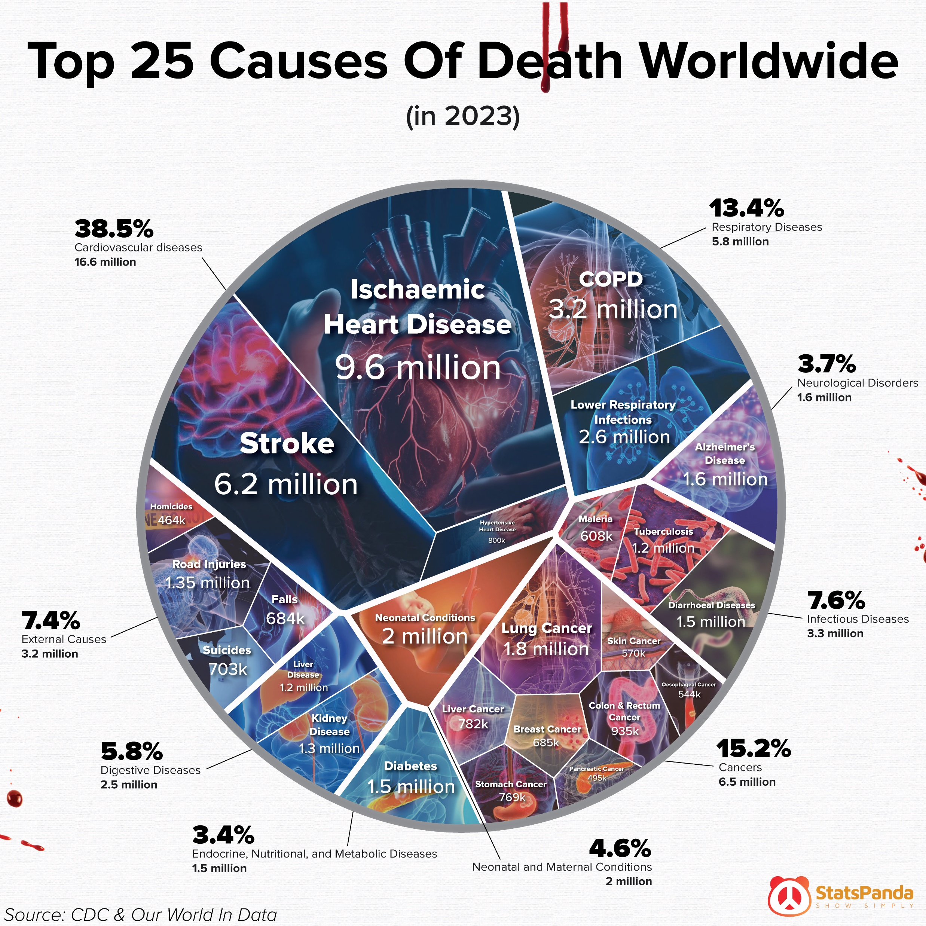

Problem Statement
Problem Cardiovascular diseases cause high mortality, but traditional ECG analysis is slow, expert-dependent, and inaccessible in remote areas. A scalable AI solution is needed to digitize and automate diagnosis.

Slide 3



Objectives
1
2
Extract P, Q,R,S, and T waves from digitized ECG images.
Analyze ECG waveforms for abnormalities.
Identify potential heart conditions using machine learning.
Classify ECG images into different categories, such as normal or abnormal.
Detect Myocardial Infarction and monitor abnormal heart rhythms.
Provide instant results for faster diagnosis and treatment.
Upload ECG images and receive automated analysis.
Instant results empower healthcare professionals with critical insights.
Advanced Signal Processing
Machine Learning Algorithms
Extract P, Q,R,S, and T waves from digitized ECG images.
Analyze ECG waveforms for abnormalities.
Identify potential heart conditions using machine earning.
Classify ECG images into different categories, such as normal or abnormal.
Real-time Diagnostic
Insights
User-friendly Web Application
Detect Myocardial Infarction and monitor abnormal heart rhythms.
Provide instant results for faster diagnosis and treatment.
Upload ECG images and receive automated analysis.
Instant results empower healthcare professionals with critical insights.
3
4

Slide 4
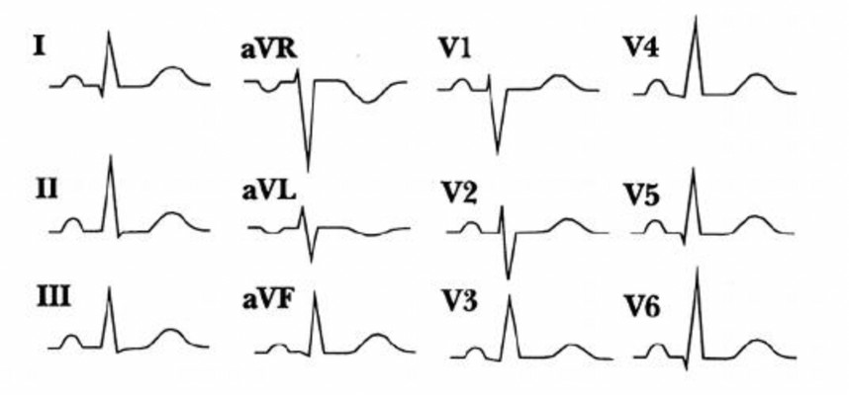
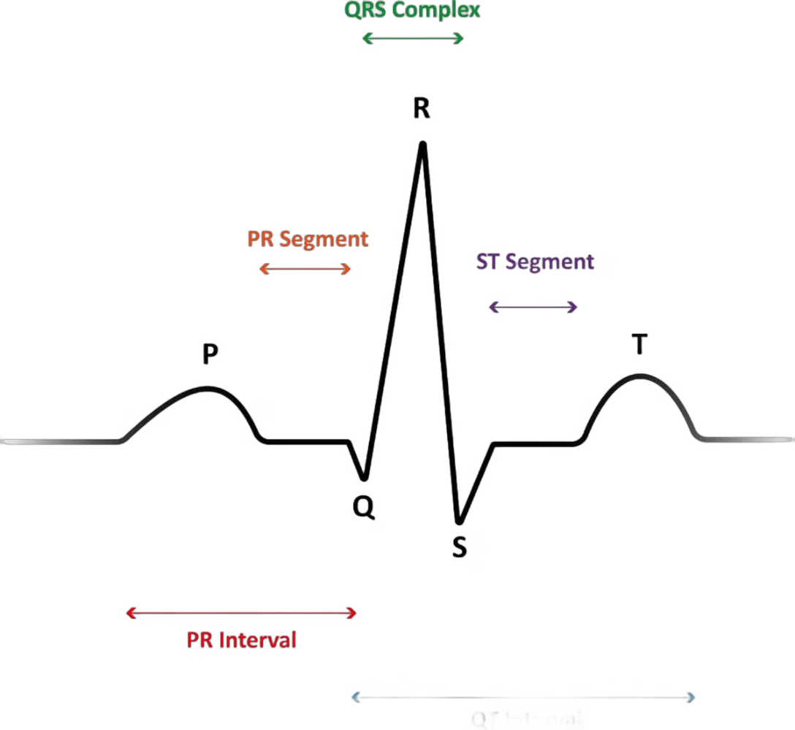
What is ECG?
If there are no ups and downs in your life you are dead!
An electrocardiogram (ECG) is a simple test that can be used to check your heart's rhythm and electrical activity.
12-lead Electrocardiogram (EKG)
Characteristics of ECG
This common type of ECG uses 10 electrodes placed on the chest and limbs to record electrical signals from different angles. It provides a comprehensive view of heart activity.

Slide 5
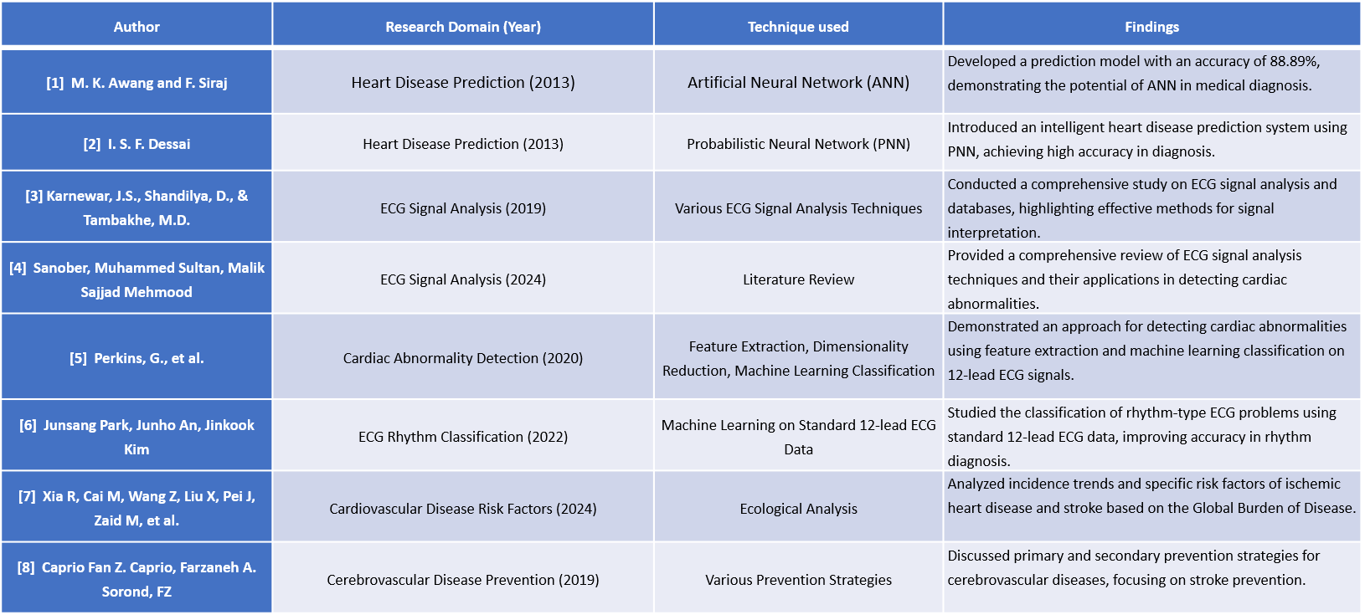
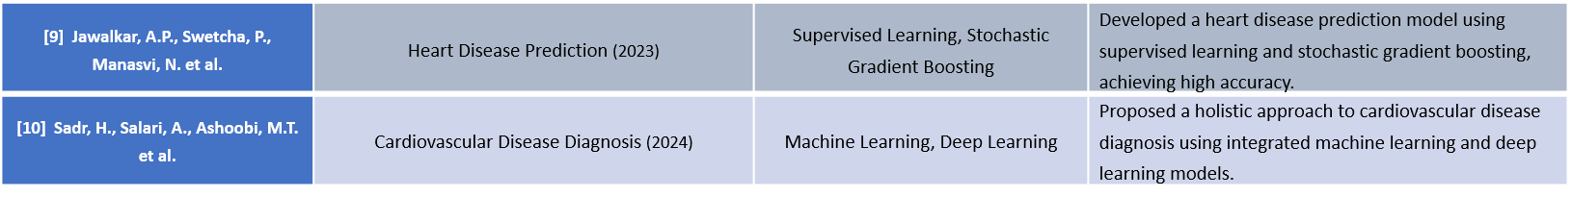
Literature Review

Slide 6




Limitations of Existing System
Manual Analysis
Time-Consuming Process
Our proposed system utilizes machine learning algorithms to analyze ECG images, aiming to automate the detection of cardiac anomalies.
Automated analysis accelerates the diagnostic process, potentially leading to earlier interventions and improved outcomes.
Limited Scalability
High Dependence on Infrastructure
The system can be accessed remotely, enabling faster diagnoses in remote areas and improving accessibility to healthcare services.
Machine learning models offer a more objective analysis, reducing the potential for human bias and enhancing diagnostic consistency.

Slide 7




Advantages of Proposed System
Automated Analysis
Faster Diagnosis
Our proposed system utilizes machine learning algorithms to analyze ECG images, aiming to automate the detection of cardiac anomalies.
Automated analysis accelerates the diagnostic process, potentially leading to earlier interventions and improved outcomes.
Remote Accessibility
Increased Objectivity
The system can be accessed remotely, enabling faster diagnoses in remote areas and improving accessibility to healthcare services.
Machine learning models offer a more objective analysis, reducing the potential for human bias and enhancing diagnostic consistency.

Slide 8
Flow Chart
Start
Data Acquisition
Preprocessing
Feature Extraction
ML Model Selection
ML Model Training
Model Evaluation
Deploy

Slide 9




ECG Dataset Collection
Normal
Myocardial Infarction
Represents ECG signals of individuals with no cardiovascular abnormalities.
Indicates ECG patterns suggestive of heart muscle damage due to blocked blood flow.
Mendeley Data
Repository
Abnormal Heartbeat
History of Myocardial Infarction
Refers to irregular heart rhythms, such as arrhythmias, detected in the ECG.
Shows past evidence of a heart attack through residual ECG changes.

Slide 10
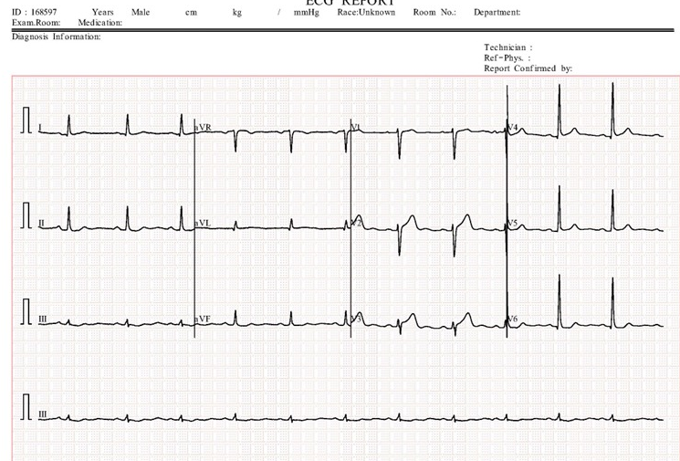
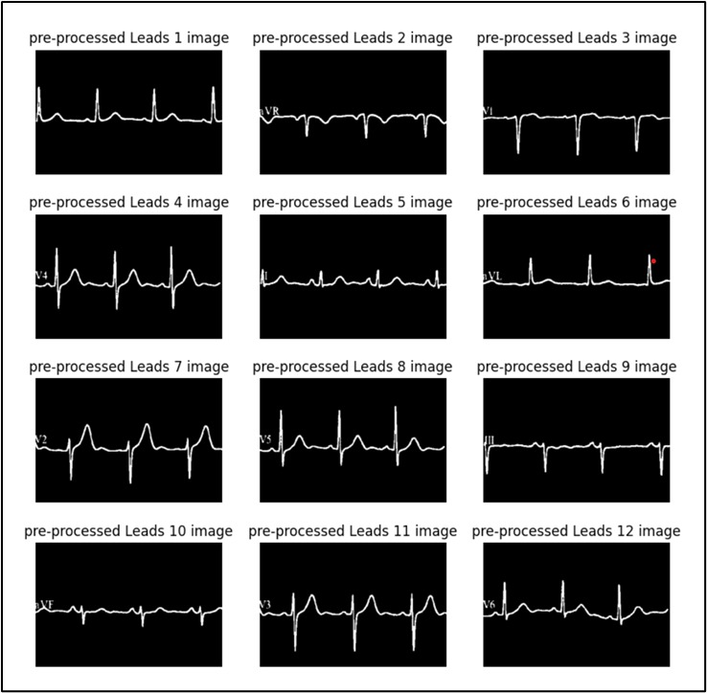
Data Preparation and Preprocessing
1
Grayscale Conversion
Converts ECG images to grayscale for simplified data representation.
2
Image Resizing
Resizes images to uniform dimensions for consistent processing.
3
Lead Extraction
Divides the image into 12 sections, extracting values for each lead.
4
Grid Line Removal
Removes grid lines from each lead image for cleaner data representation.

Slide 11
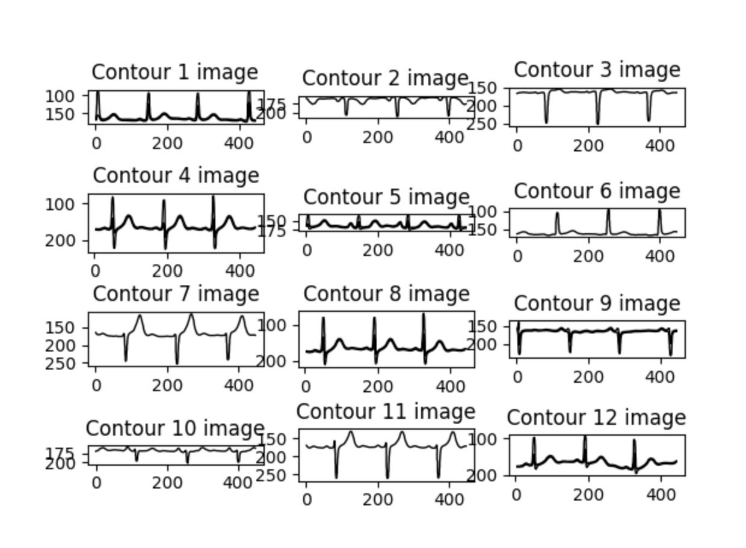
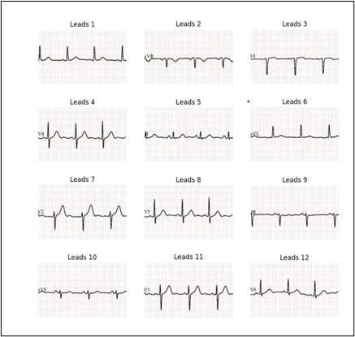
Data Preparation and Preprocessing
5
Contour Signal
Contour signal for each lead (1-12)
6
Multiple csv files with each lead values
Lead 1-12 values in separate csv file for all images
7
Combined CSV
one combined csv file of 12 lead signal values for processing

Slide 12



Data Feature Extraction & Data Engineering
ECG Signal Segmentation
1
Divides the ECG signal into 12 leads, converting each lead into a 1D array.
Feature Extraction
2
Focuses on time-domain features, such as RR intervals, PR and QT intervals, and waveform contours.
Data Engineering
3
Prepares the extracted features for training and evaluating the machine learning models.

Slide 13
ML Model
Data Collection
1
Sources ECG data from the Mendeley repository, comprising labeled samples of ECG images.
Data Preprocessing
2
Applies preprocessing techniques, such as grayscale conversion and noise reduction, to prepare the data.
Feature Extraction
3
Extracts time-domain features, such as RR intervals, PR and QT intervals, and waveform contours.
Model Training
4
Trains machine learning models, such as KNN, SVM, Logistic Regression, and Ensemble classifiers.

Slide 14
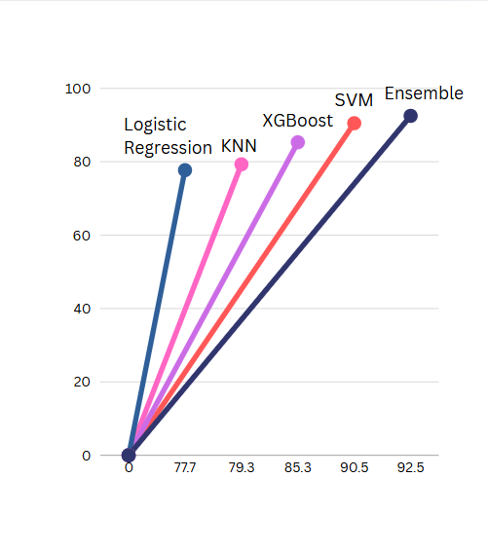
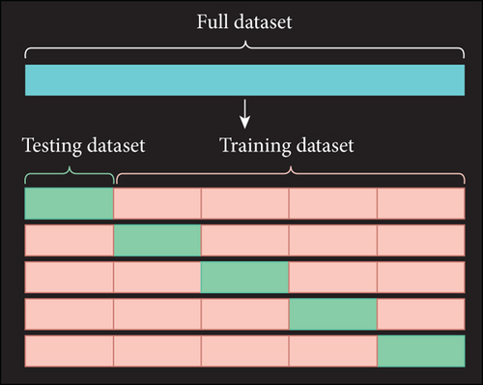
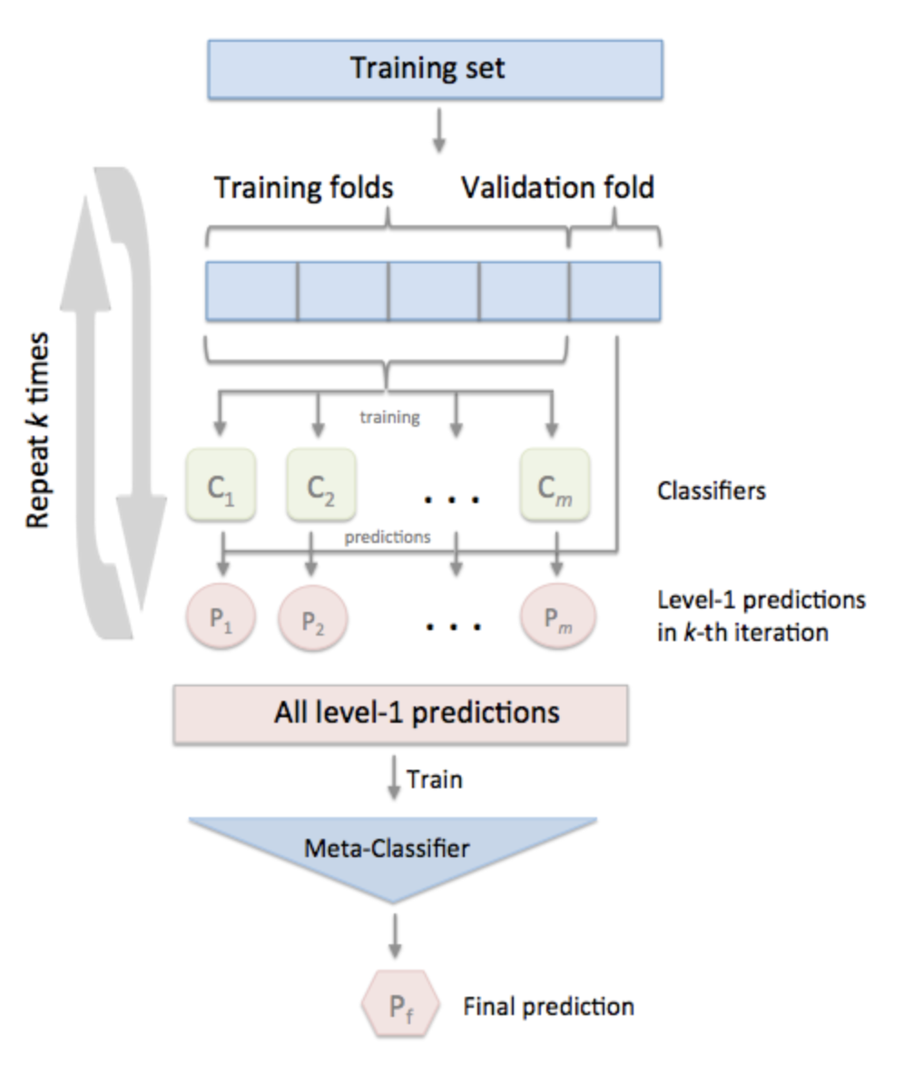
ML Model
We tested various algorithms and then utilized the enable technique to stack algorithms to enhance performance because it was a classification problem.
GridSearchCV for
Hyperparameter Tuning
Ensemble of stacking multiple
models using voting classifier
Algos Tested

Slide 15
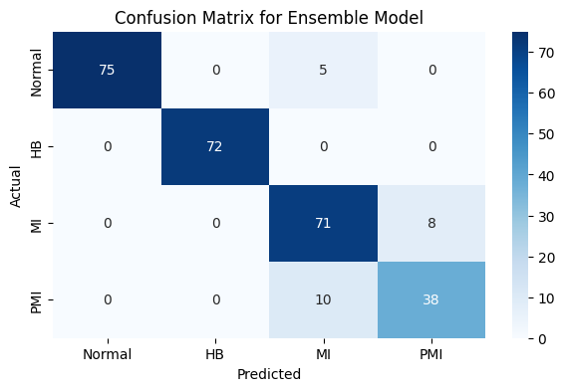
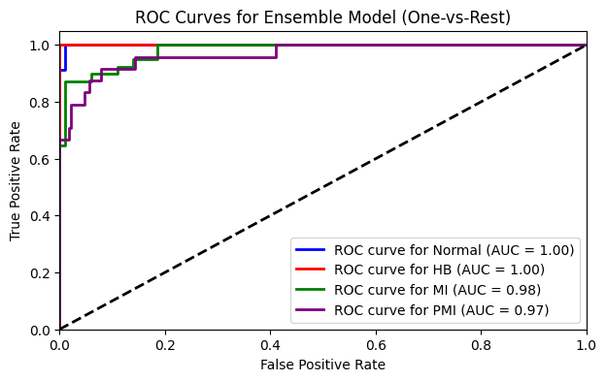
Model Evaluation Plot
MODEL | TRAIN-TEST SPLIT | ACCURACY | F1-SCORE
K-Nearest Neighbors | 60-40 | 79.3% | 0.79
Logistic Regression | 60-40 | 77.7% | 0.77
Support Vector Machine | 60-40 | 90.5% | 0.90
XGBoost | 65-35 | 85.3% | 0.85
Ensemble (Voting) | 70-30 | 92.5% | 0.92

Slide 16
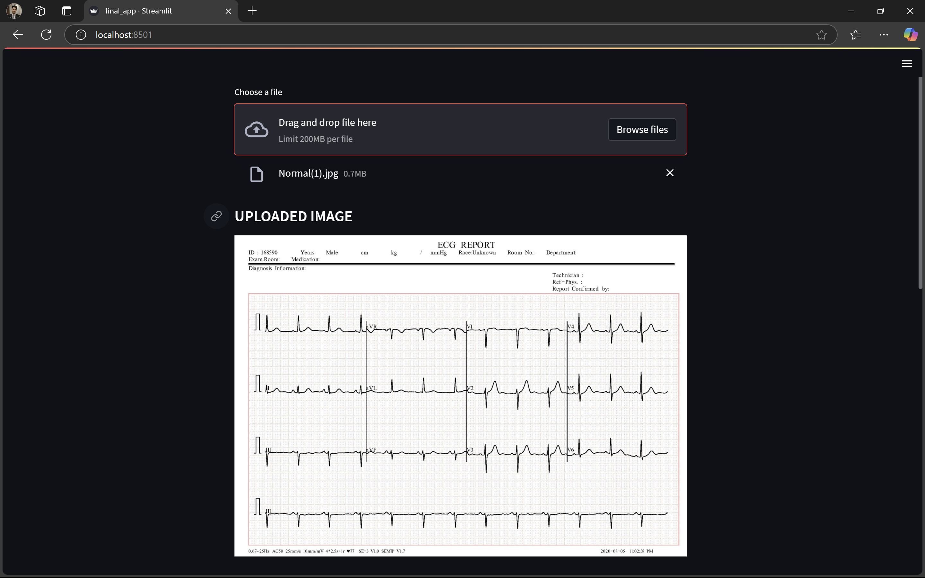
Raw ECG signal before preprocessing

Slide 17
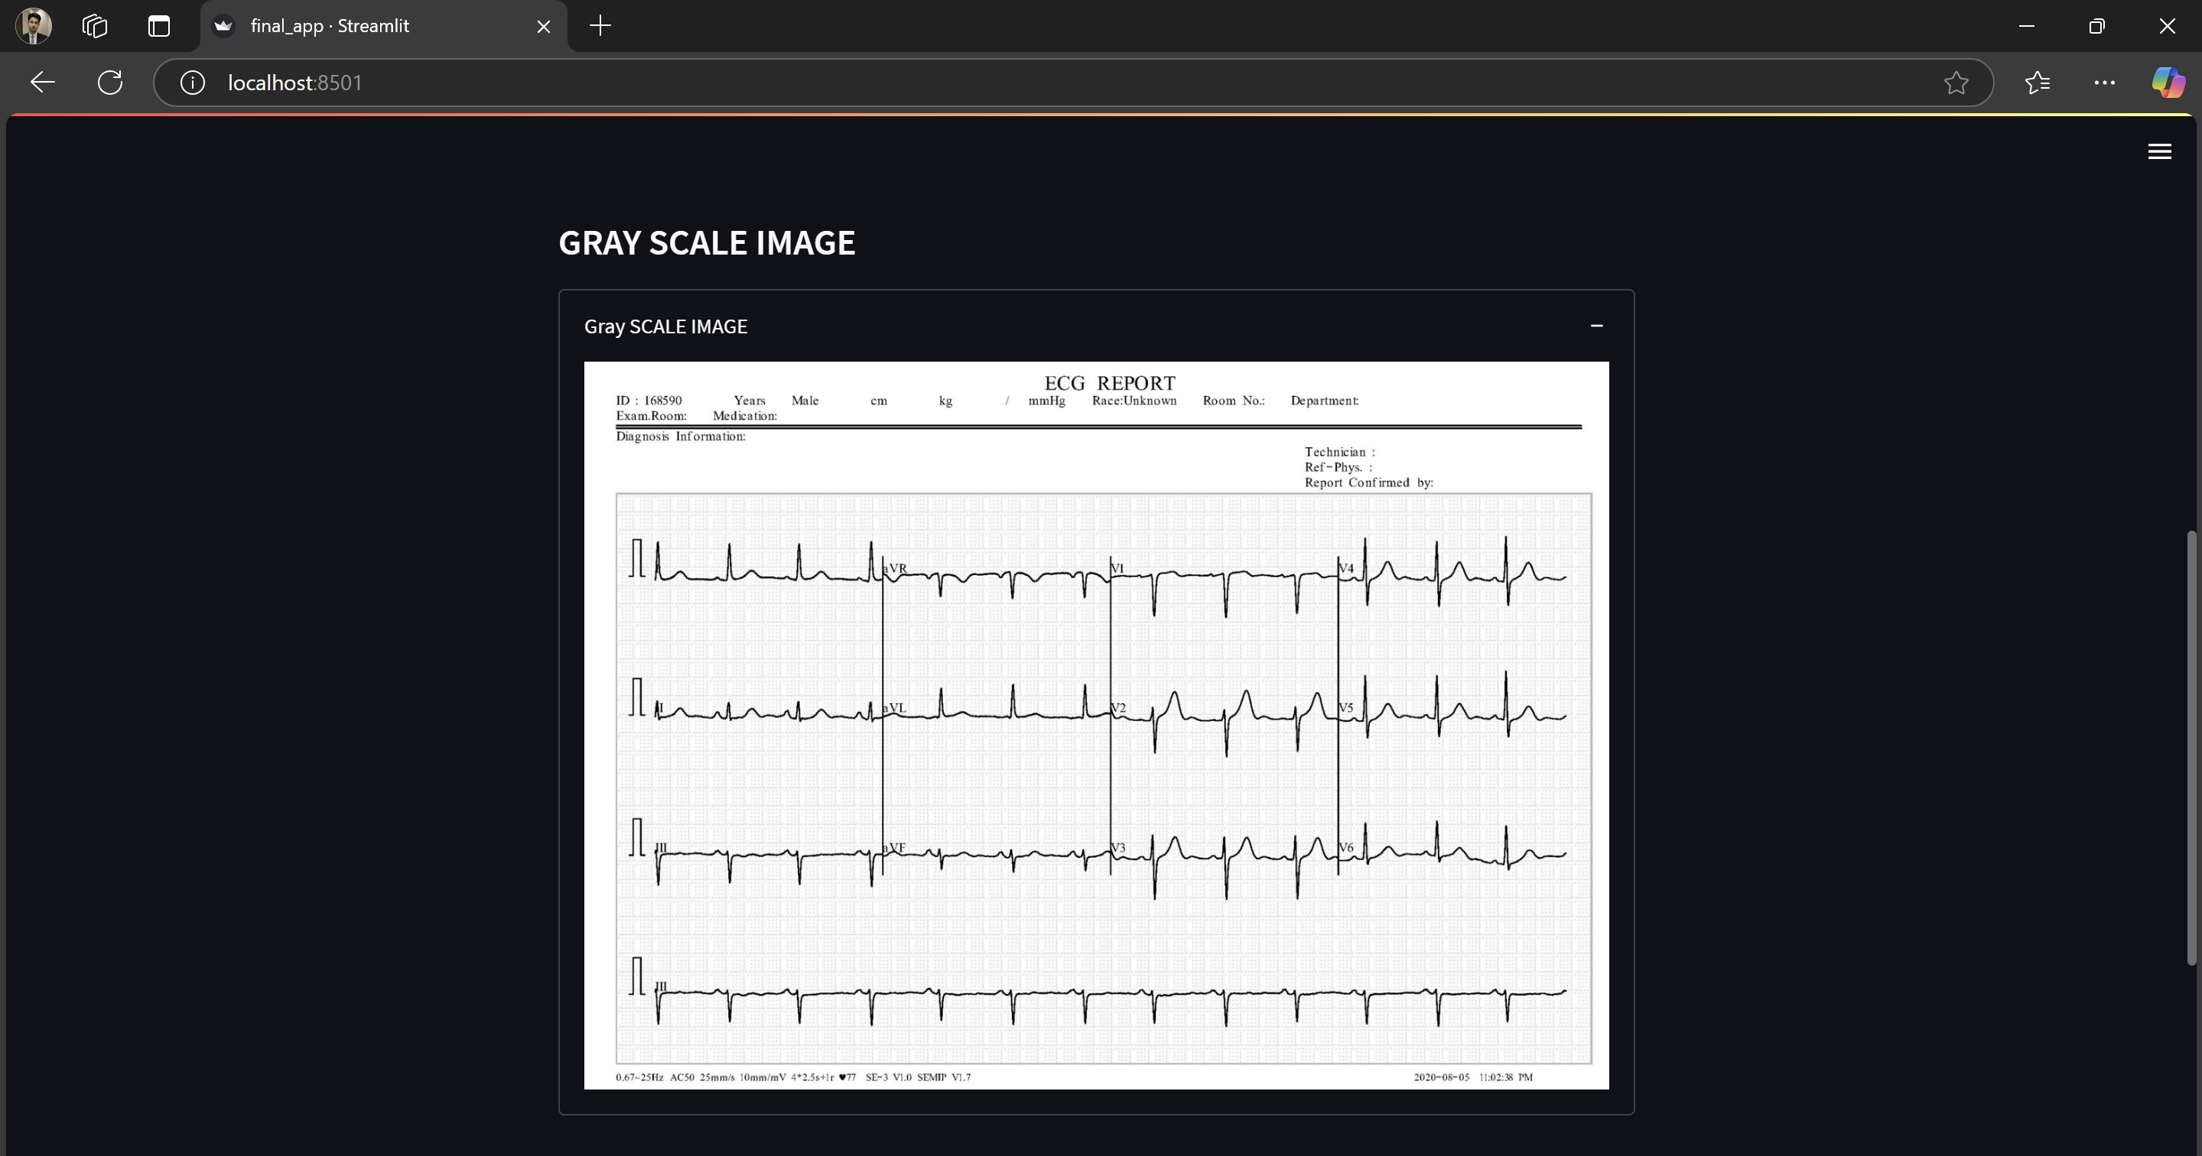
Enhances signal focus by removing color complexity

Slide 18
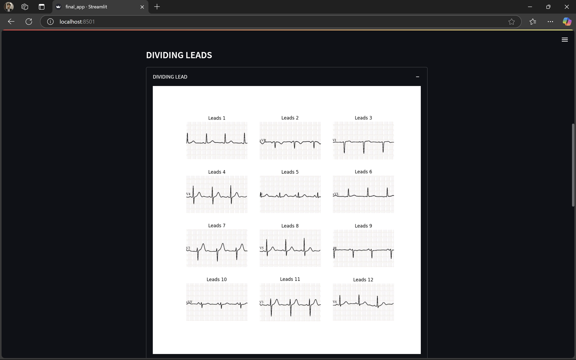
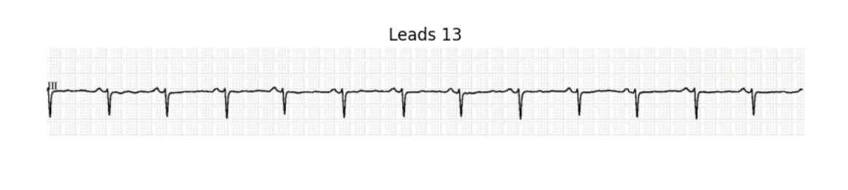
ECG signal split into 12 standard leads for analysis

Slide 19
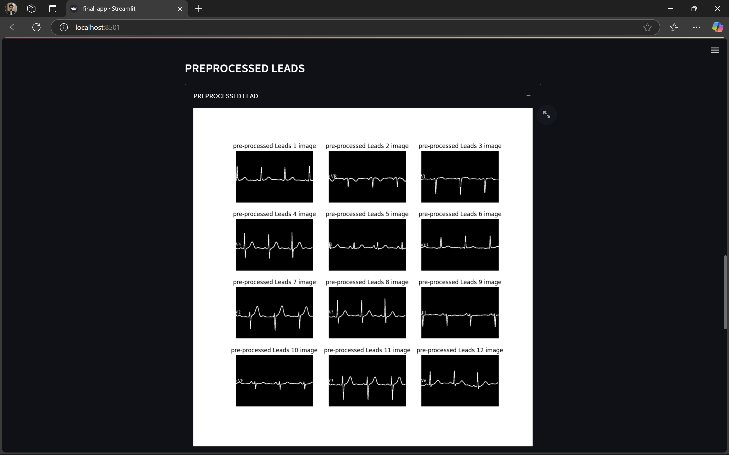

Gridlines removed using thresholding

Slide 20
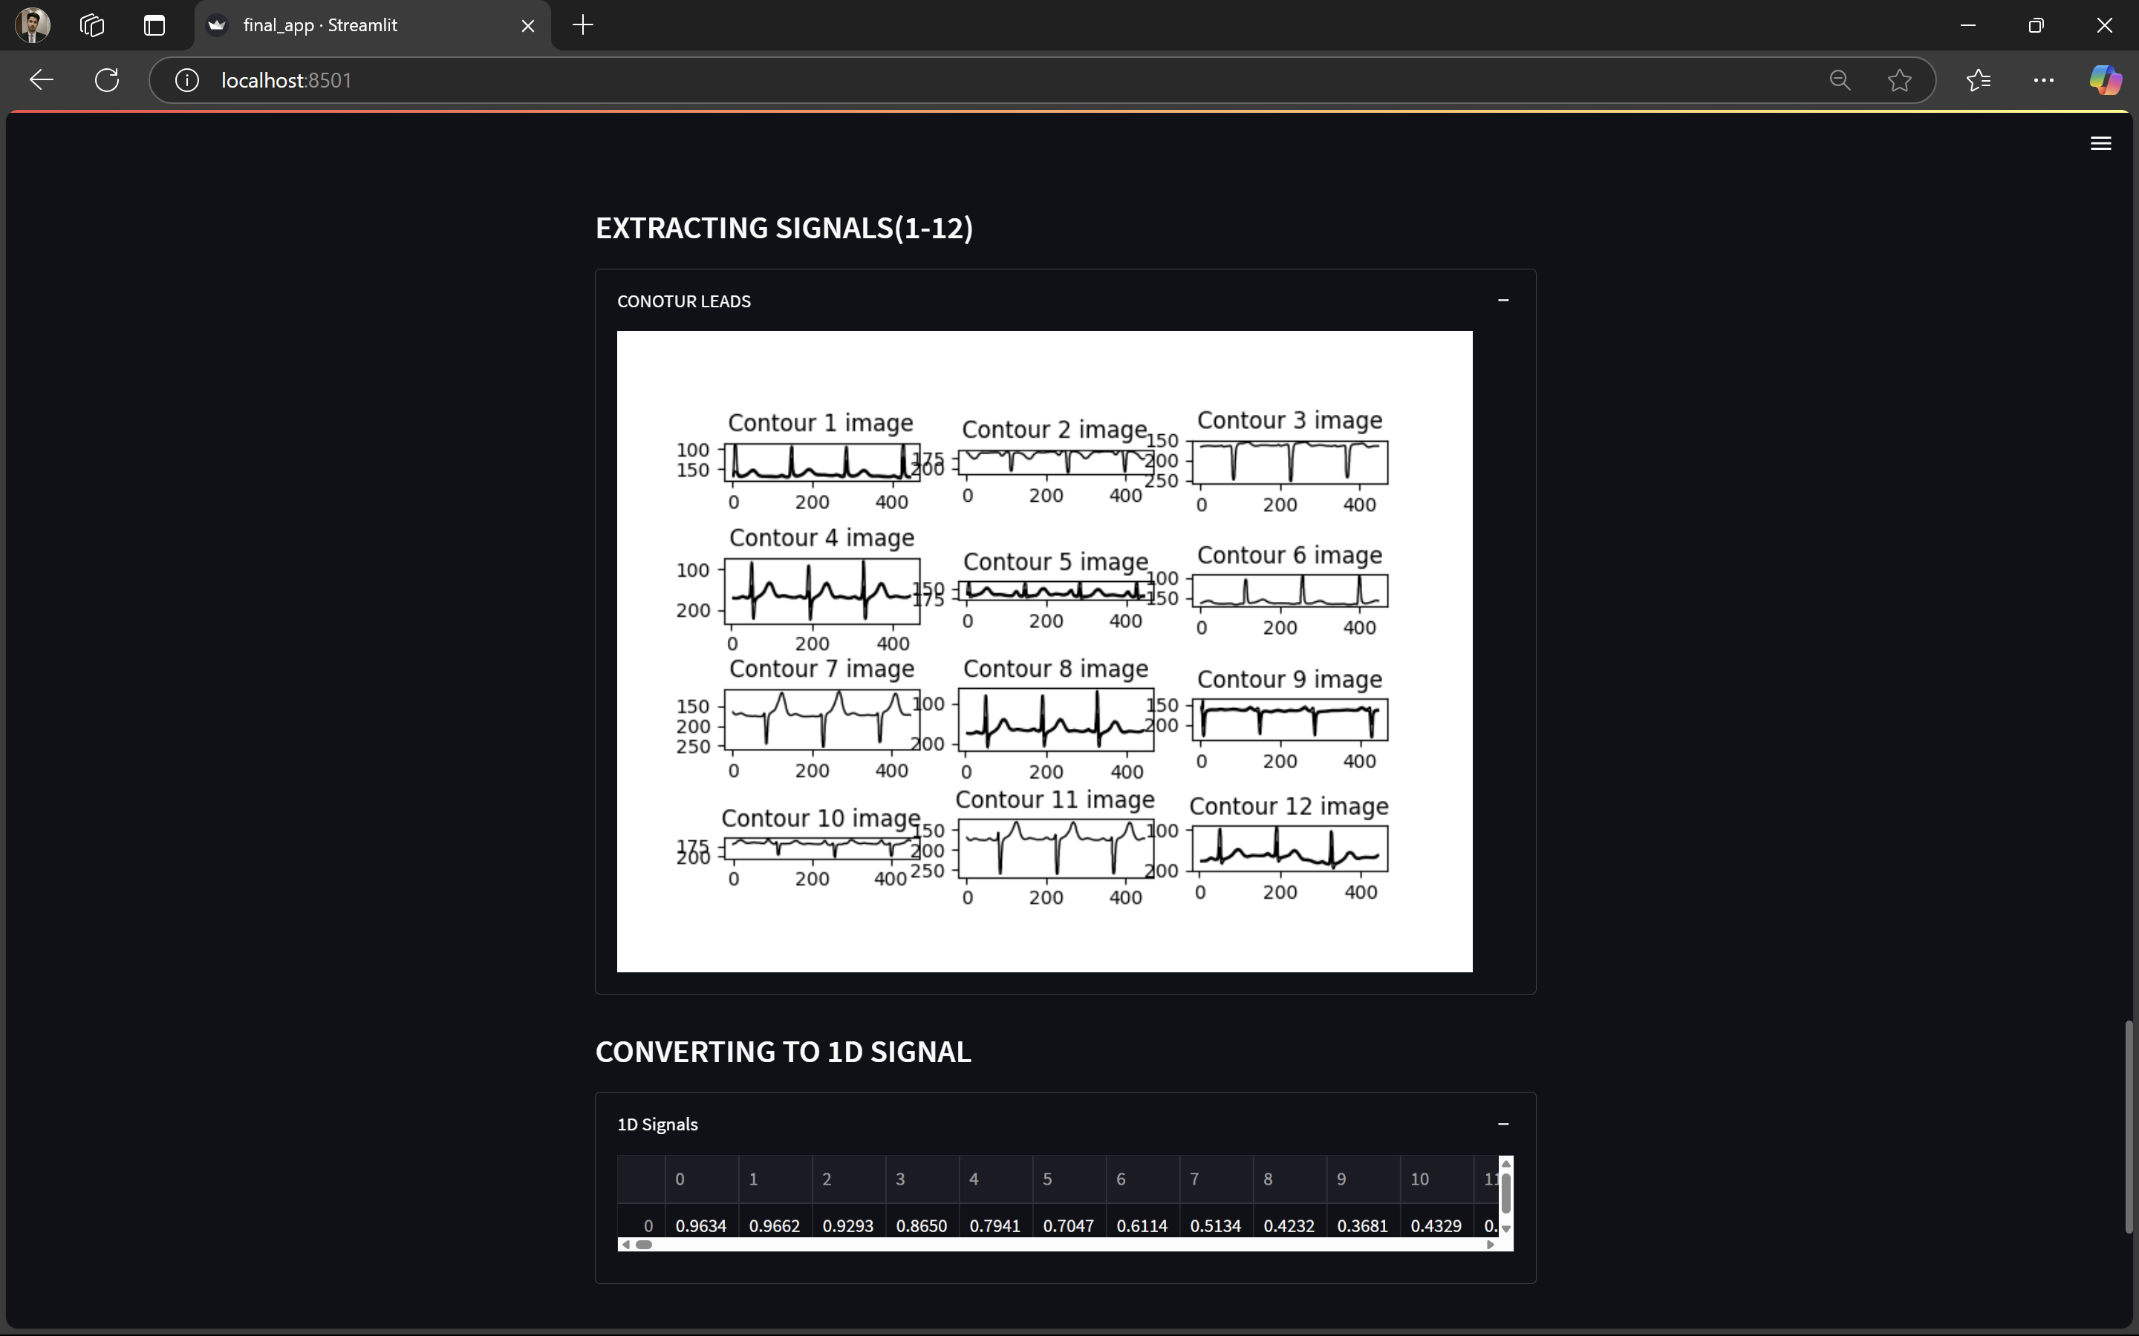
Signals extracted using contour tracing

Slide 21
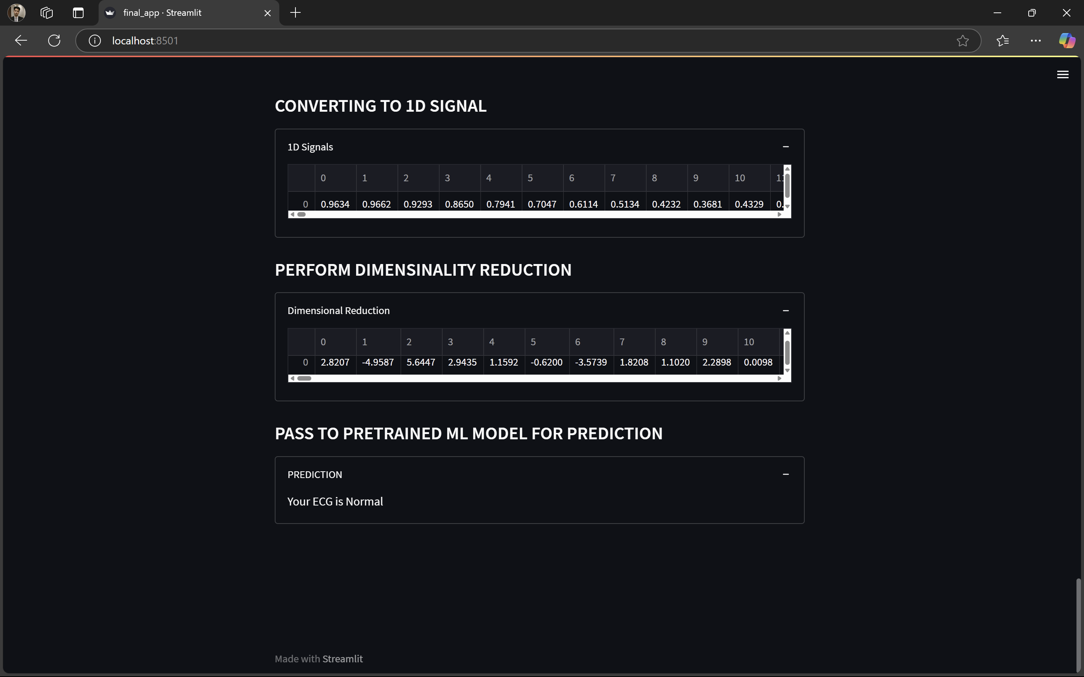
Final Prediction

Slide 22







Architecture Diagram
User
Internet
Upload ECG Image In Web App
Image Processing
Results
Pretrained ML Model

Slide 23







Deployment Architecture
Python
GitHub
Docker
User
User interface
Web Service

Slide 24
THANK
YOU

